Slide 1
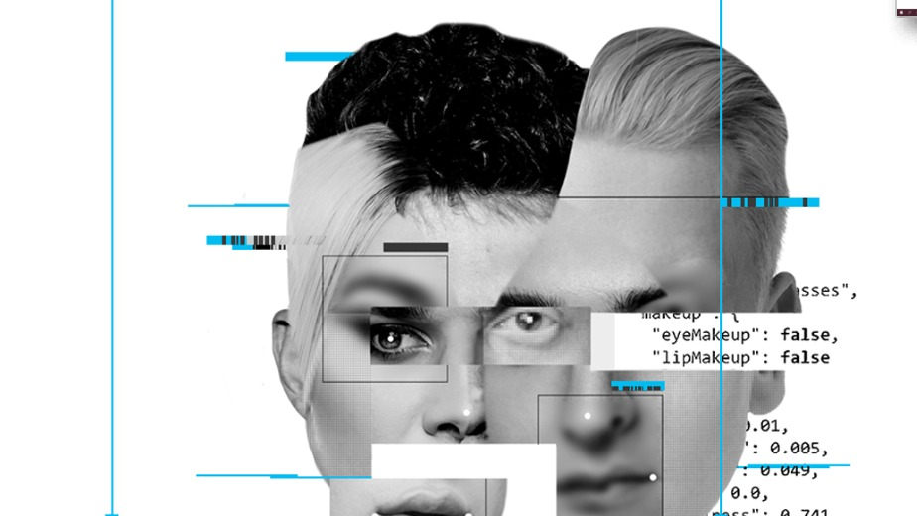
Age & Gender Detection
Team Pink Panthers:
Divija Kambhampati
Harshitha Shabad
Sayali Kardile
Payal Sen

Slide 2







R
O
A
D
M
A
P
6. Prediction
5. Analytics
4. Data Augmentation
2. ETL Process
3. Data Visualization
1. Data Source

Slide 3

Gender - Age Identification
Easy Task for Humans
Complex Task for Machine

Slide 4
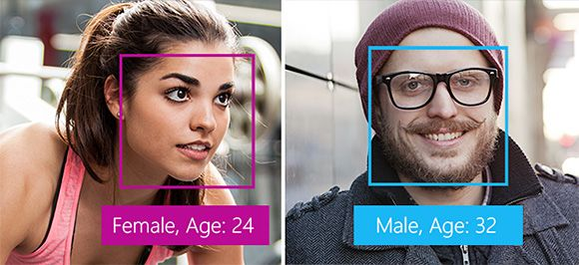
Our Proposal
To develop a gender and age detection algorithm
Receive an image as an input and estimate the age and gender of the individual
Adult
Adult

Slide 5
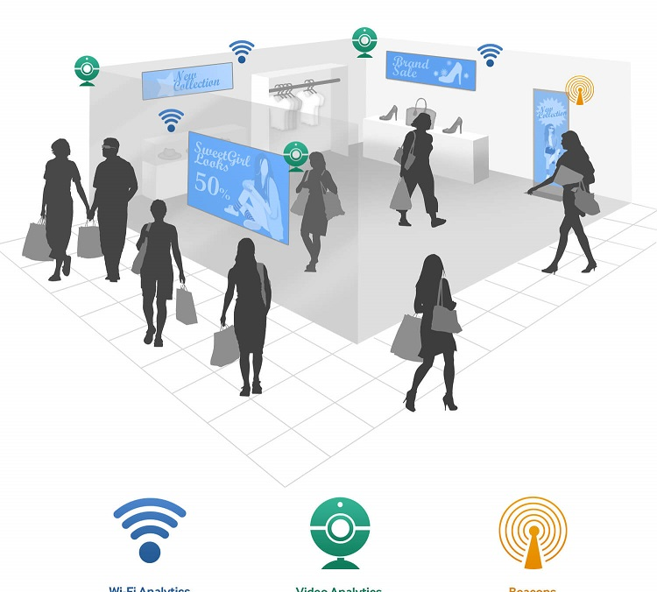
What will Gender & Age Prediction technology allow marketers to do? BETTER ADVERTISEMENT

Slide 6
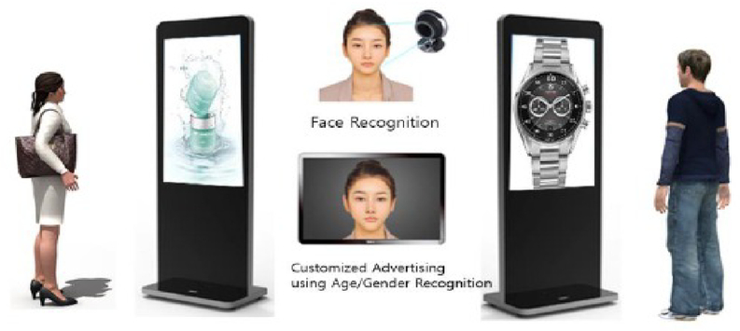
Business Use Case
Creating smart displays that target ads to individual customers

Slide 7


Target
Audience

Slide 8
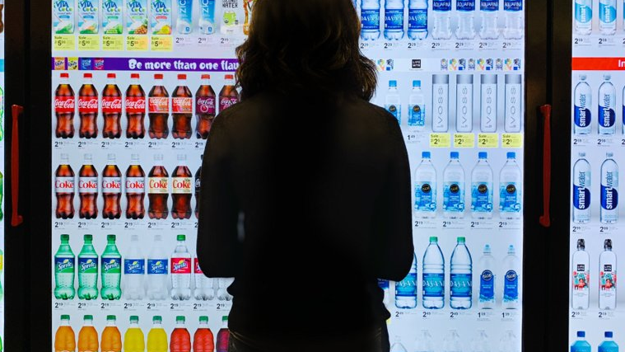
How Gender & Age Prediction is making advertising more effective?

Slide 9








Slide 10
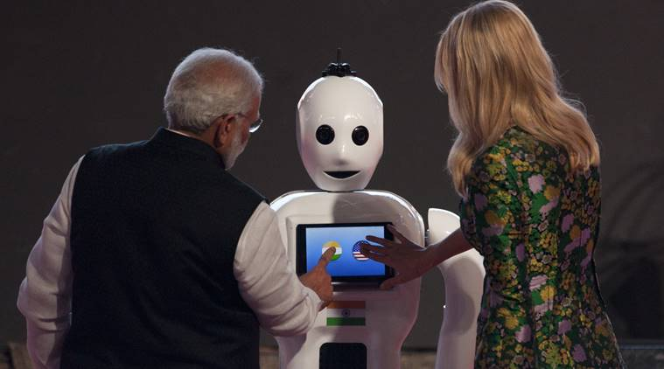
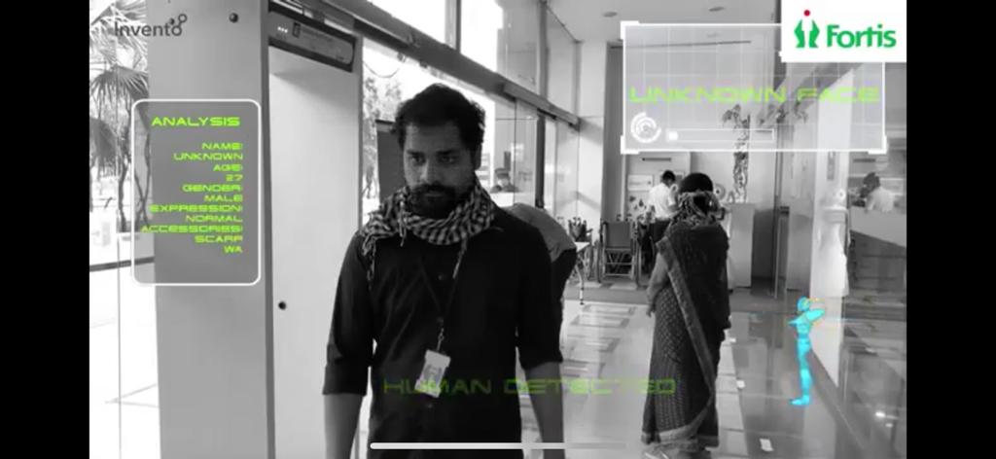
Real Time Application - Age & Gender Prediction
MITRA Robot
Humanoid Robot
Has Age & Gender Prediction Capability

Slide 11
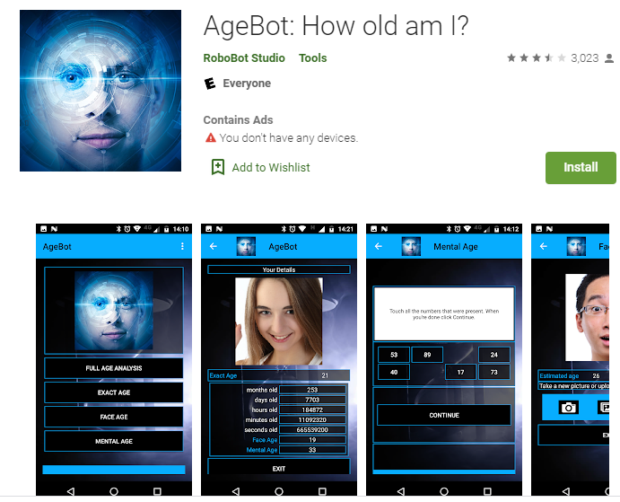
Real Time Application
Age Bot

Slide 12
Data Source

Slide 13
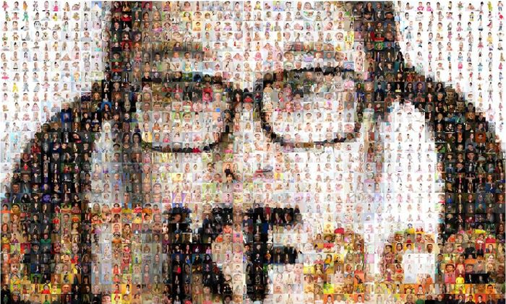

Slide 14
Data Source
UTK Dataset and Real Time Webcam Data
20K+ Face images
Images are labelled by age, gender, and ethnicity
Age span ranges from 0-116 years old
The images cover large variation in pose, facial expression, illumination, occlusion, resolution, etc

Slide 15

UTK Face Data set
The labels of each face image is embedded in the file name, formatted like [age]_[gender]_[race]_[date&time].jpg
Data set could be used for:
Face Detection
Age estimation
Race Detection

Slide 16
ETL process
Extract
Extract from UTK dataset
Transform
Other extension to JPG
Load
Load input data

Slide 17

Transformation

Slide 18
Data Visualization

Slide 19
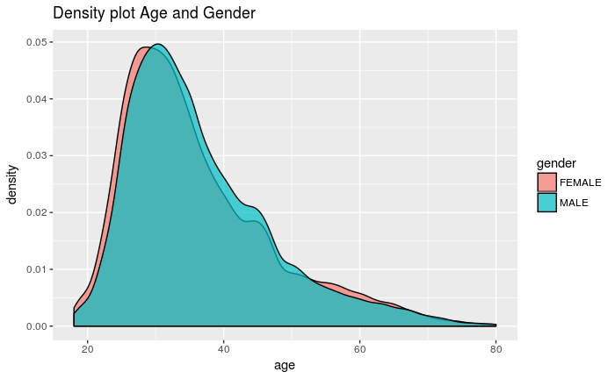
Data Visualization
Check for outliers
Check for normal distribution

Slide 20
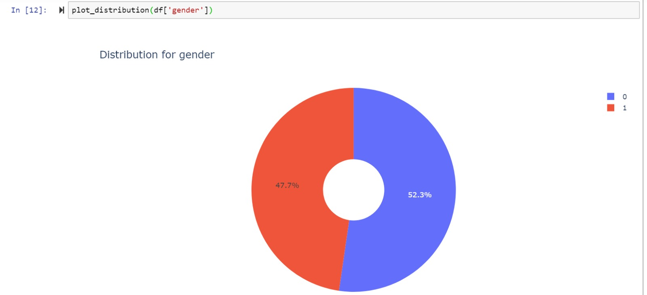
Gender Distribution

Slide 21
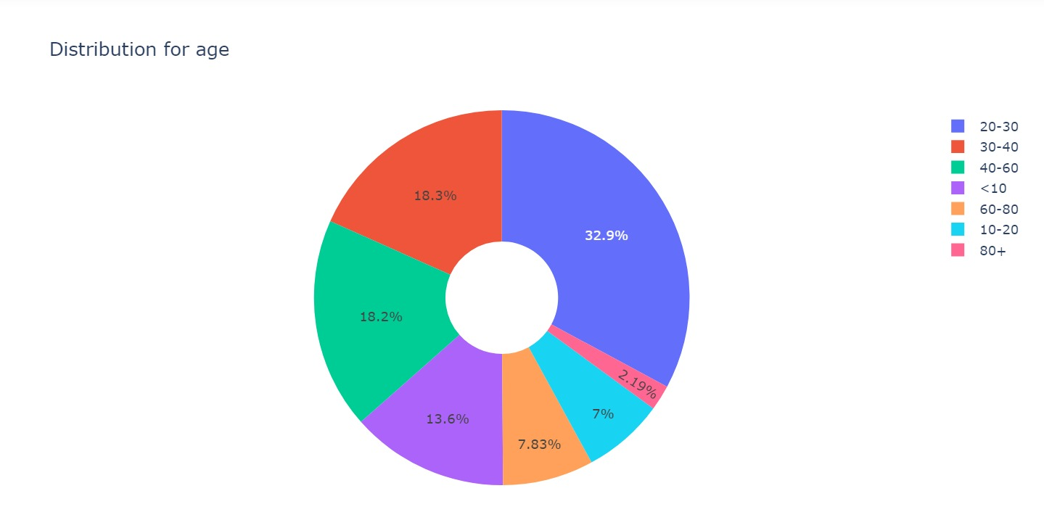
Age Distribution

Slide 22
Image Transformation

Slide 23
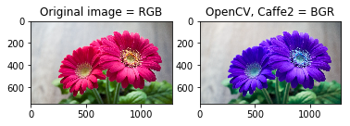
BGR to RBG

Slide 24
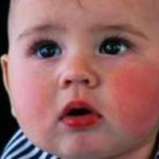

Image Resize

Slide 25
Data Augmentation

Slide 26
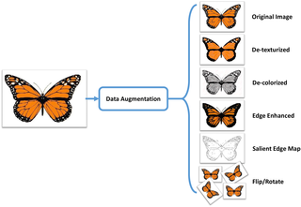
Data Augmentation
Significantly increases the diversity of data available for training models, without actually collecting new data.
Techniques such as cropping, padding, and horizontal flipping are commonly used to train large neural networks.
Improves model efficiency
ImageDataGenerator

Slide 27





Flip - Rotate - Zoom - Shear - Width Shift - Height Shift

Slide 28
Rotate

Slide 29


Zoom

Slide 30


Flip

Slide 31
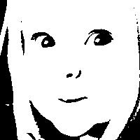
Black and White

Slide 32


Skew

Slide 33




Shear

Slide 34
Inception V3 Model – inception_v3_weights_tf_dim_ordering_tf_kernels_notop.h5
By Google
widely-used image recognition model
Pre–trained model

Slide 35
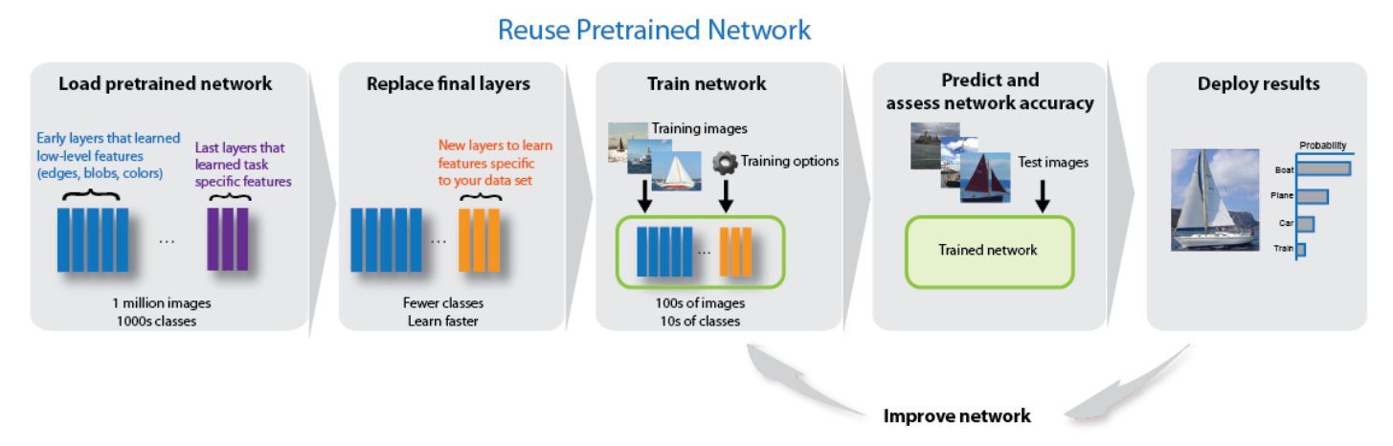
Inception V3 Model

Slide 36
Layers: 10
Epochs: 50
Duration to run: 4 days
Inception V3
Age Prediction
Gender Prediction

Slide 37
Best Model saved based on Validation Loss
Age Accuracy : 28%
Gender Accuracy : 52 %
Challenges faced !!

Slide 38
Challenges
Deciding no of layers
Deciding on different parameters in layers, Compile
Deciding on number of epochs
Saving checkpoint

Slide 39
CNN
No Pre-trained model
Less time to Run
Epochs:100
Layers:3 CNN layers & 3 dense layers
Accuracy : Age- 87%,Gender-89%

Slide 40
Sample Outputs

Slide 41
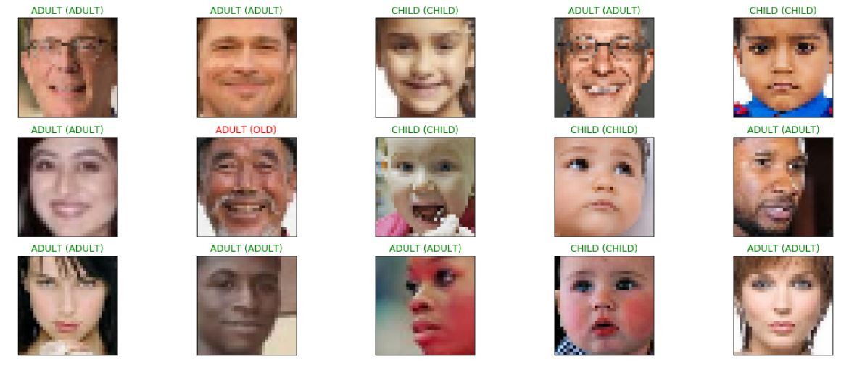
Age

Slide 42
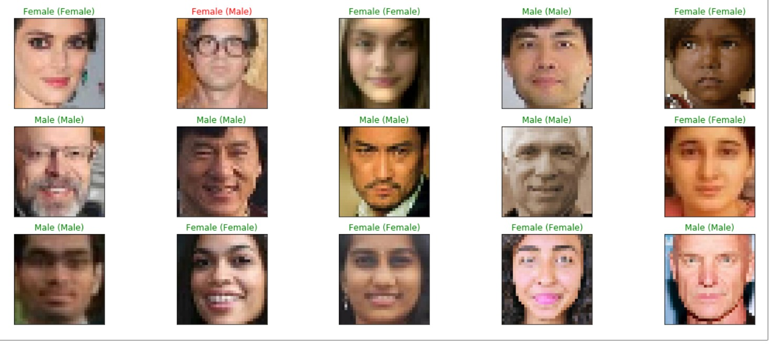
Gender

Slide 43
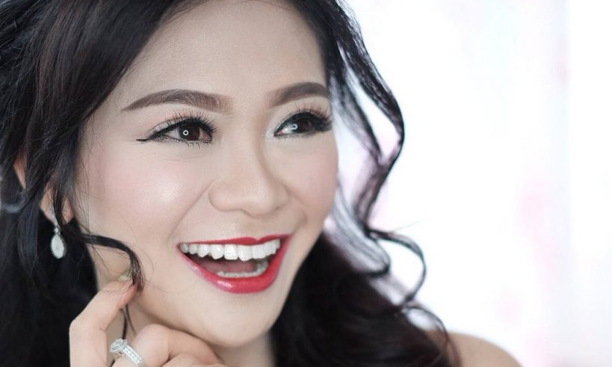
When human eyes can get deceived with her age - no wonder our training model did!

Slide 44
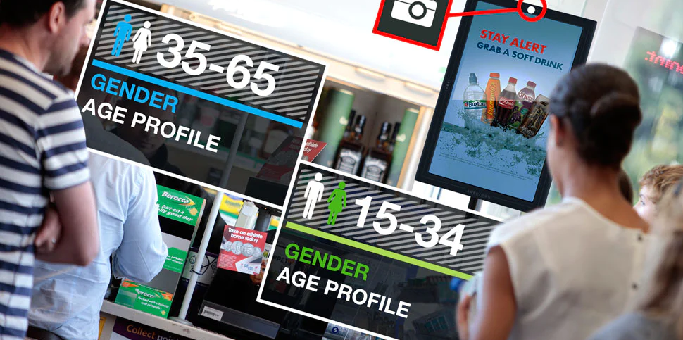
Prediction
Input Real time image
Feed image to Model
Predict Age in Buckets
Predict Gender
Advertisement – Use case
Adult
Adult

Slide 45
Reference
Nolen,Sam(2019, Jul 02). GANs for Data Augmentation. Retrieved from https://medium.com/reality-engines/gans-for-data-augmentation-21a69de6c60b
Ahmad,Jamil.,Muhammad,Khan.,Baik,Sung Wook.(2017, Aug 31).Data augmentation-assisted deep learning of hand-drawn partially colored sketches for visual search. Retrieved from https://journals.plos.org/plosone/article?id=10.1371/journal.pone.0183838
Tawhid,Nurul Ahad.,Dey,Emon Kumar.(2018, Feb). A Gender Recognition System from Facial Image. Retrieved from https://www.researchgate.net/publication/323346551_A_Gender_Recognition_System_from_Facial_Image
Chernov,Pavel(2019, Apr 29). Age and gender estimation. Open-source projects overview. Simple project from scratch. Retrieved from https://medium.com/@pavelchernov/age-and-gender-estimation-open-source-projects-overview-simple-project-from-scratch-69581831297e
Dr. Dataman(2019, Jul 18). What Is Image Recognition?. Retrieved from https://towardsdatascience.com/module-6-image-recognition-for-insurance-claim-handling-part-i-a338d16c9de0
Kuligowski, Kiely(2019, Jul 18). Facial Recognition Advertising: The New Way to Target Ads at Consumers. Retrieved from https://www.businessnewsdaily.com/15213-walgreens-facial-recognition.html
Chauhan, Nagesh Singh(2018, Nov 20). Predict Age and Gender using Convolutional Neural Network and openCV. Retrieved from https://towardsdatascience.com/predict-age-and-gender-using-convolutional-neural-network-and-opencv-fd90390e3ce6

Slide 46


